Slide 1
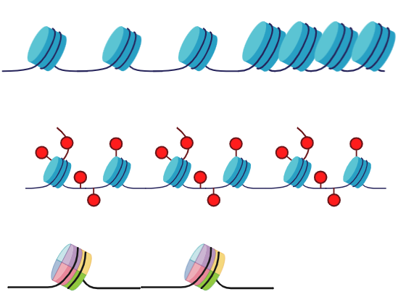
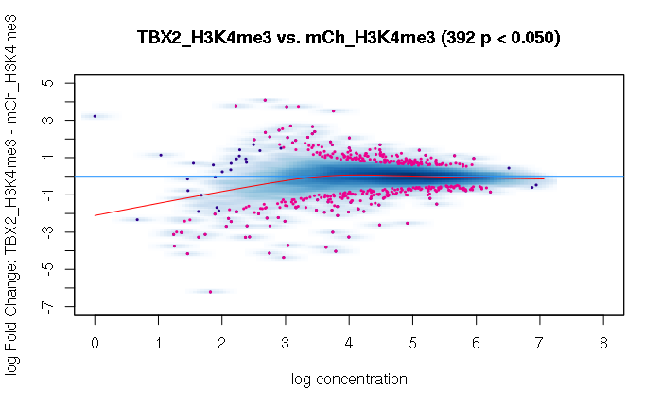
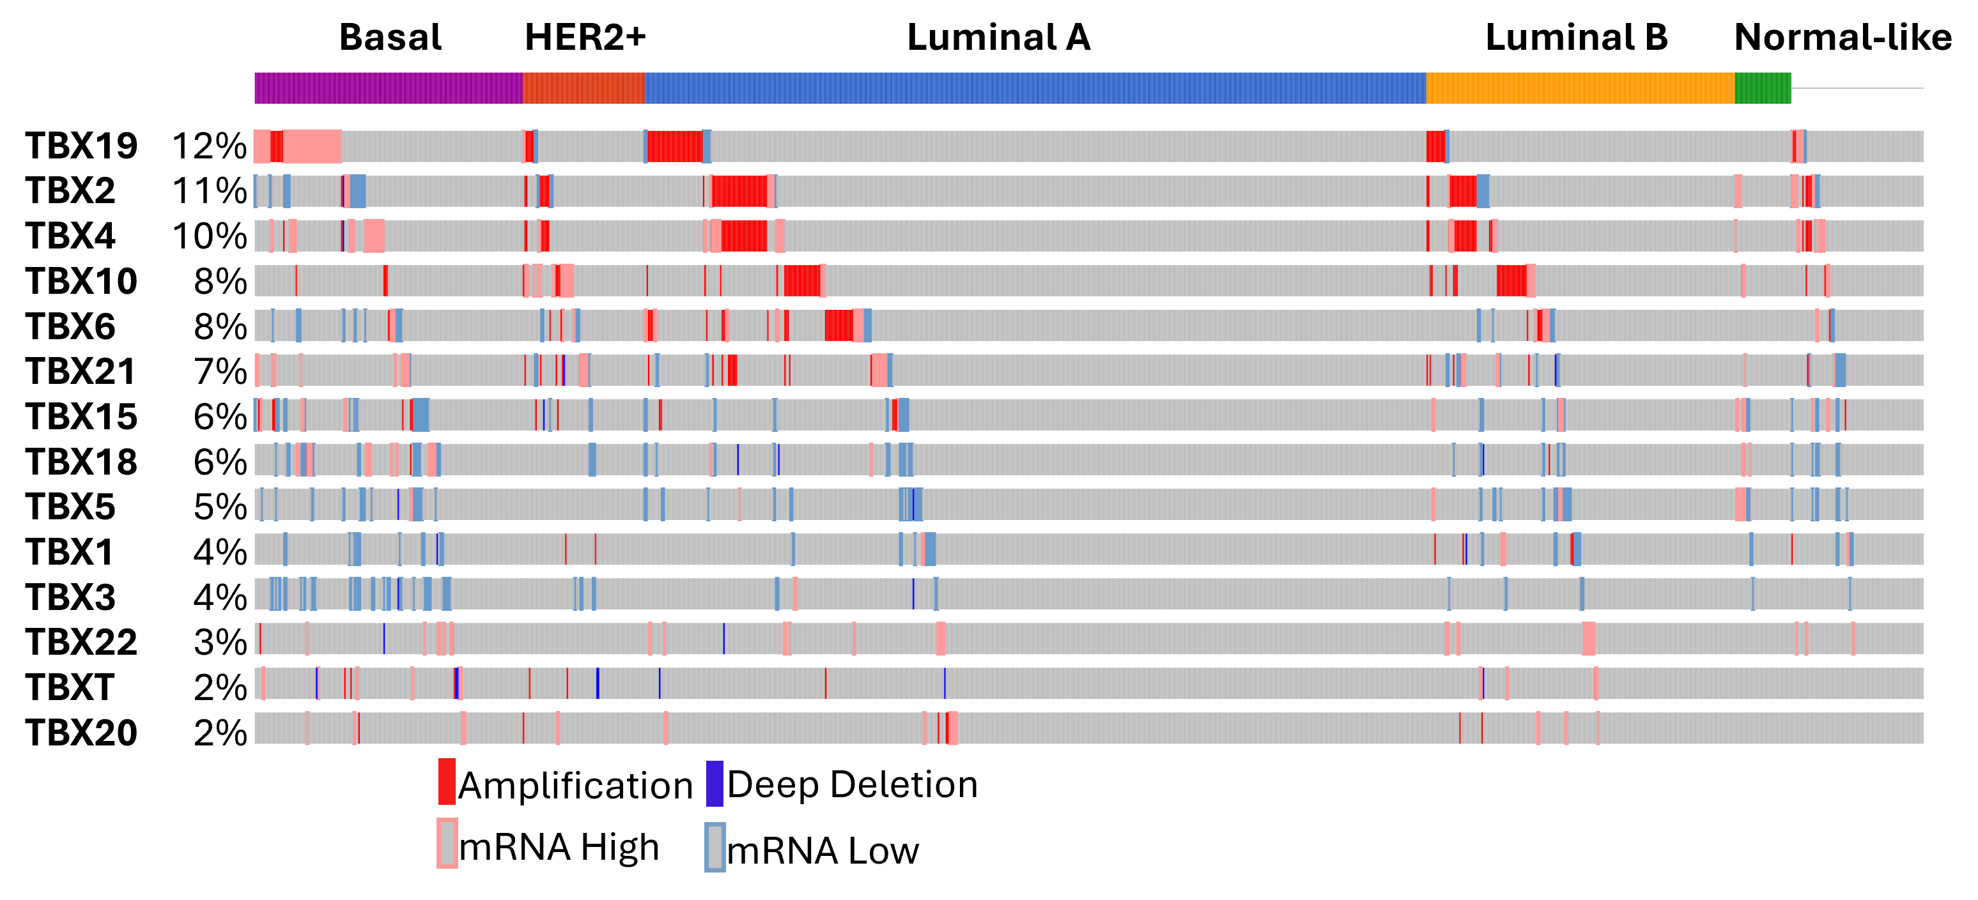
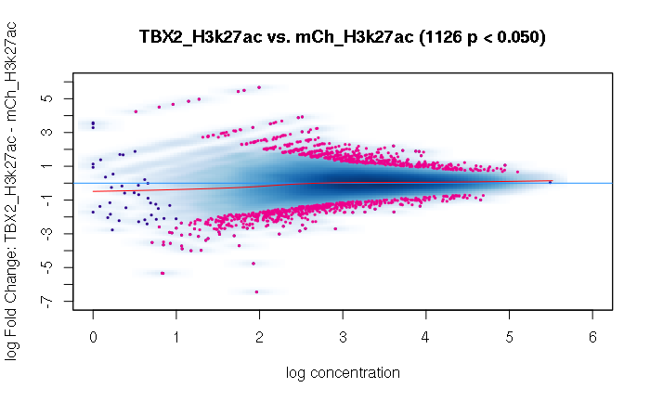
Epigenomic Profiling of oncogenic TBX2 in Mouse Mammary Epithelial Cells(mMEC) as a model for Breast Cancer
Martinluther Winn ^{1,2}, Wazim Mohammed Ismail, Ph.D², Amik Munankarmy, Ph.D², Fergus J. Couch, Ph.D², Alexandre Gaspar Maia, Ph.D²
University of Florida Genetics Institute, Gainesville, FL, USA¹, Department of Laboratory Medicine and Pathology, Mayo Clinic, Rochester, MN, USA ²
Introduction
CUT&RUN Chromatin Analysis
Remap Enrichment
Method
Breast cancer
1/8 women will be diagnosed
30% of diagnosis of cancer in women
Subtypes: Luminal A, Luminal B, HER2+, TNBC
Epigenomics
Our research primarily focuses on the H3.3 histone variants and its histone modifications H3K27ac, which marks active enhancer and promoter activity, and H3K4me3, which marks active Transcription site and promoter activity, the histone variant macroh2a modifications. The H3 histone is responsible for regulating transcription, replication and DNA repair. Macroh2a is unique because it’s associated with inactive chromatin by inducing repressive chromatin states. However, there is a subset of enhancers that modulate cell identity and reactivation in cancer can lead to increased stemness.
T-box genes and Transcription factors
T-box genes are essential during embryogenesis. However, they are also involved in cancer epithelial-mesenchymal-transition, which promotes migration, and amplified stemlike qualities that contribute to cancer malignancy and severity. TBX2 has an oncogenic role in cancer by allowing cells to bypass senescence, promoting proliferation, and promoting invasion of cancer into tissue. We are studying TBX2 to identify the specific binding sites for the gene that it regulates downstream. This can potentially be used as a target in drug development.
.
A
B
CUT&RUN Chromatin Analysis
Processing of the FASTQ file obtained from CUT&RUN assay was conducted in a Unix HPC environment using VSCode as a development platform. Trimming was preformed in parallel with all the samples using Trim galore and subsequently conducted quality analysis by Bowtie2. Samtools was used in the trimming process to create a bam file which would be used by in the next stage to create a no duplicate bam file and convert it to a bed file using Bedtools’ bamtobed function. The bed file was then converted to a bigwig file using BedGraphToBigWig.
Differential Binding Affinity Analysis
Wiggletools averaged the replicates samples bedgraph files and then the bed graph files were converted to bigwig files for TBX2 and mCh H3K4me3 and H3K27ac. The SEACR command was used to subtract the IgG control bedgraphs from the other samples to reduce noise. Bigwigcompare is the comparison of the signal ratio for the IgG to the samples. In RStudio and utilizing the edgeR and DIffBind package the mplots were created from the sample bam files to the averaged bed files.
Remap Enrichment
The remapEnrich library was used to create an enrichment dot plot using a predownloaded mm10 genome and the significantly enriched sites in both H3K27ac and H3K4me3 that were depleted and enriched taken from the Diffbind analysis to to identify target specific target genes of interest.
Combination Matrix Analysis(CMA)
The bed files of the depletion and enrichment of H3K4me3 and H3K27ac in both control and Overexpression conditions were put into galaxy to create upset plots.
A
A
D
C
Figure 1: Diagram of chromatin state
Euchromatin is loose and allows regulatory elements to easily access the DNA. While heterochromatin is closed and is transcriptional inactivated. Chromatin markers such as acetylation and methylation of histones control this process.
B
B
E
Figure 6: DotPlots of the significant enriched and depleted sites on H3K4me3 and H3K27ac
KDM5A was enriched in sites where H3k4me3 was depleted after overexpression of TBX2 enhancing repression. ESR2 is binding is enriched in H3K4me3. ING1 is depleted in H3K4me3. TCF4, NR6A1 and, FOSL1 is enriched in H3K27ac.
Figure 3: University of Santa Cruz(UCSC) Genome Tracks
CUT&RUN is a type of omics that allow for analysis of DNA-Protein binding and chromatin modifications. It allows us to capture the specific transcription factor of interest and their integration with DNA, or histone post translational modification, by attaching antibodies that allow the target to precipitate out of the cell and isolate after A-Mnase cuts the DNA. We utilized UCSC’s genome browser to identify TIAM (A) and CD4A(B).
Combination Matrix Analysis
conclusions
Figure 4: Upset plot
Visualized intersections between open-chromatin regions of Basal, Luminal Progenitors, and Luminal Mature cells (identified using single cell mutiome), and the TBX2 binding sites.
Differential Binding Affinity Analysis
The overexpression of TBX2 in mMECs have a histone demethylation effect possibly by the KDM5A binding.
TCF4, NR6A1 and FOSL1 are enriched in H3K27ac when TBX2 is overexpressed suggesting enhanced stemlike traits.
Overexpression TBX2 shown by CMA suggest cells overlap with undifferentiated cells
A
Figure 7: Mplots of TBX2 expression in both H3K4me3 and H3K27ac
(A) Significant depletion of H3K4me3 which signals that the overexpression of TBX2 induces chromatin remodeling that leads to increased transcriptional repression. (B) The slight increase in enrichment suggest TBX2 induces transcriptional activity.
references
B
Mohammed Ismail, W., Mazzone, A., Ghiraldini, F.G. et al. MacroH2A histone variants modulate enhancer activity to repress oncogenic programs and cellular reprogramming. Commun Biol 6, 215 (2023).
Chang F, Xing P, Song F, Du X, Wang G, Chen K, Yang J. The role of T-box genes in the tumorigenesis and progression of cancer.(2016)
Allis, C. D., & Caparros, M.-L. (2015). Epigenetics ed. C. David Allis, Marie-Laure Caparros, Thomas Jenuwein, Danny Reinberg. Cold Spring Harbor Laboratory Press. .
Yoo, J., Kim, G.W., Jeon, Y.H. et al. Drawing a line between histone demethylase KDM5A and KDM5B: their roles in development and tumorigenesis. Exp Mol Med 54, 2107–2117 (2022).
Lyu, P., Settlage, R.E. & Jiang, H. Genome-wide identification of enhancers and transcription factors regulating the myogenic differentiation of bovine satellite cells. BMC Genomics 22, 901 (2021)
Wang, Y., Wan, X., Hao, Y. et al. NR6A1 regulates lipid metabolism through mammalian target of rapamycin complex 1 in HepG2 cells. Cell Commun Signal 17, 77 (2019)
Sheridan C, Kishimoto H, Fuchs RK, Mehrotra S, Bhat-Nakshatri P, Turner CH, Goulet R Jr, Badve S, Nakshatri H. CD44+/CD24- breast cancer cells exhibit enhanced invasive properties: an early step necessary for metastasis. Breast Cancer Res.(2006).
Figure 5: Upset plot
Visualized intersections of H3K4me3 and H3K27ac in TBX2 overexpression and mCh (control) condition, and the TBX2 binding sites.
Figure 2: Oncoprint graph of Tbox genes that displays the alterations in each subtype of cancer
TBX19, TBX2, and TBX4 exhibit an increase in alterations compared to the other T-box genes. TBX2 is known to have oncogenic properties in breast cancer. However, the mechanism is not known.

